Slide 1
Angular basic components and app initialization
What is Angular Framework?
What is the difference between AngularJS and Angular?

Slide 2
App initialization
What is a bootstrapping module?

Slide 3
JIT (just in time)
AOT (ahead of time) 8v +
Compiled in the browser.
Each file compiled separately.
No need to build after changing your code and before reloading the browser page.
Compiled by the machine itself, via the command line (Faster).
All code compiled together, inlining HTML/CSS in the scripts.
No need to deploy the compiler (Half of Angular size).
More secure, original source not disclosed.
What is JIT?
What is AOT?
What are the advantages with AOT?

Slide 4
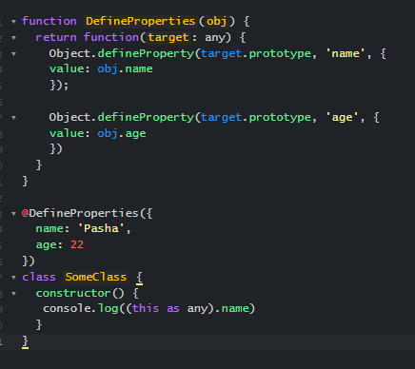
Typescript decorator and simple decorator example
What is a decorator
Can we put 2 decorators in a row (make a chain)?
What is a metadata

Slide 5
Decorators in Angular
Class decorators, e.g. @Component, @Directive and @NgModule
Property decorators for properties inside classes, e.g. @Input and @Output
Method decorators for methods inside classes, e.g. @HostListener
Parameter decorators for parameters inside class constructors, e.g. @Inject
What types of decorators exist in Angular

Slide 6
Directives
Component directives
Structural directives
Attribute directives
What type of directives exist?
What are the differences between Component and Directive?
What is a directive in Angular?

Slide 7
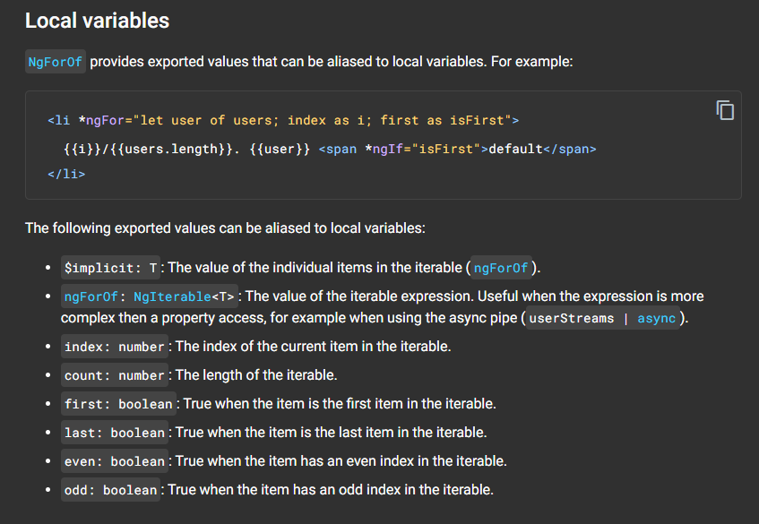
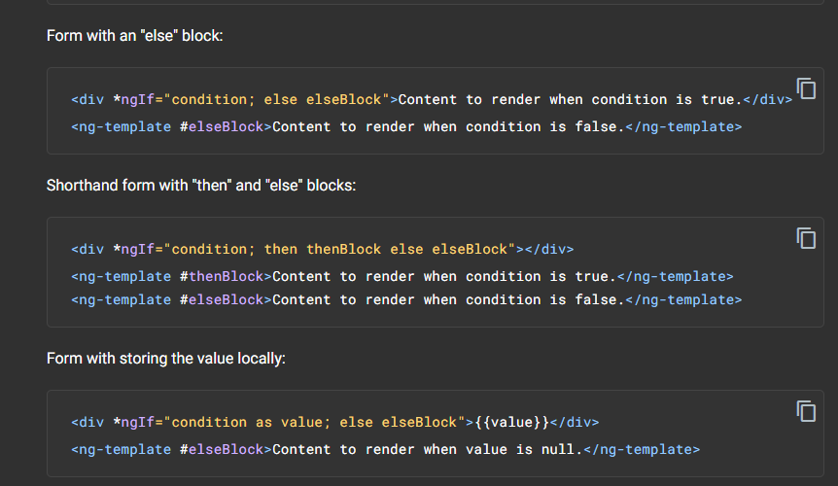
Structural directives
*ngFor
*ngIf
What is the purpose of *ngFor directive?
What is the purpose of *ngIf directive?

Slide 8
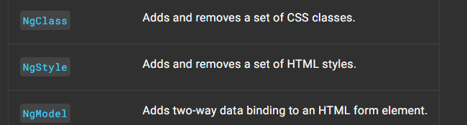
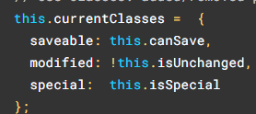
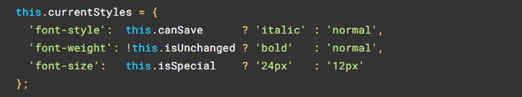

Attribute directives

Slide 9
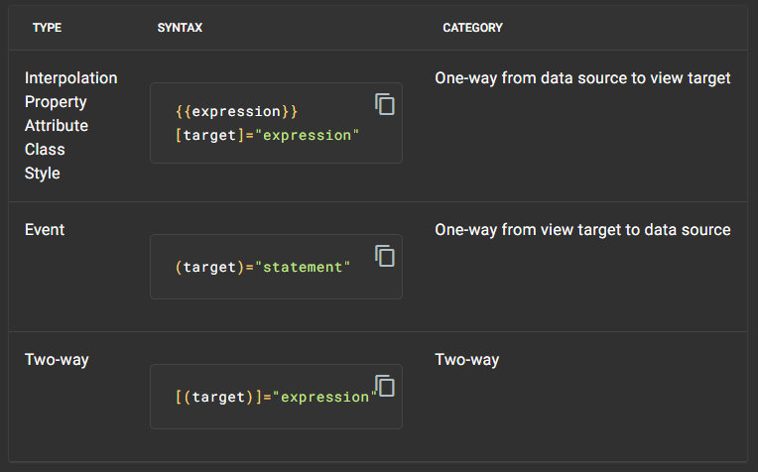
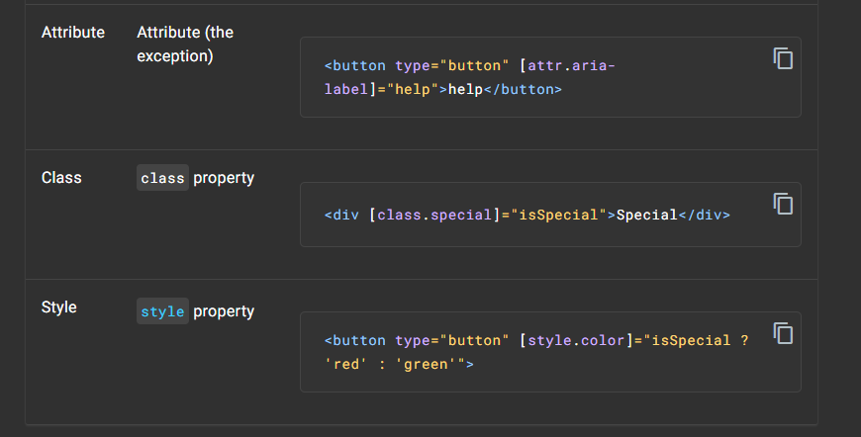
Binding
What is a data binding?
How do you categorize data binding types?

Slide 10
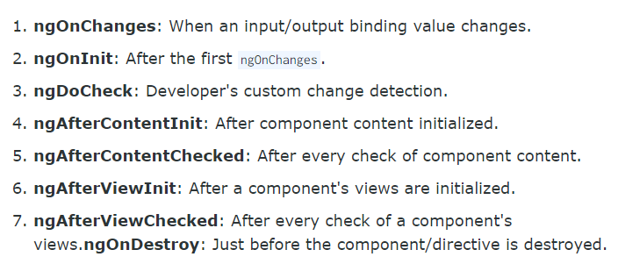
Hooks
What are lifecycle hooks available?

